Slide 1
Data Warehousing SS ZG515
PC Reddy
Guest Faculty – WILP, BITS Pilani

Slide 2
Data Warehousing – Lecture 14
Agile Business Intelligence
Hadoop & SAP HANA

Slide 3
What is Agile BI?
Agile is an iterative and incremental (evolutionary) approach to software development which is performed in a highly collaborative manner with ‘just enough’ ceremony.
Focus is on minimizing risk by delivering new functionality in short timeframes, often measured in weeks.
Agile is a “style” of working –not a process or methodology.
Agile business intelligence addresses a broad need to enable flexibility by accelerating the time it takes to deliver value with BI projects.

Slide 4
Guiding Principles for Agile
Satisfy the customer through early and continuous delivery of valuable software
Welcome changing requirements
Deliver working software frequently (weeks to couple of months)
Daily collaboration between developers and business experts
Build projects around motivated individuals
Face-to-face conversations
Simplicity--the art of maximizing the amount of work not done
Self-organizing teams
At regular intervals, the team reflects on how to become more effective, then tunes and adjusts its behavior accordingly

Slide 5
Agile vs. standard DW/BI approach
Deliver business value (but faster in Agile)
Develop iteratively, incremental manner (shorter increments in Agile)
Collaboration, ongoing face-to-face communication with the business (higher and more frequent in Agile - cohabitate and work side-by side)
Adapt to evolving requirements (quicker in Agile - evolutionary approach)

Slide 6
Agile Architecture for BI
Agility without control leads to chaos.
Agile architecture is keeping the natural data warehouse evolving and minimizing rework
Be open to refactoring and revising the architecture. Conforming dimensions and consolidating staging areas are examples of refactoring.
Thin slice the architecture horizontally rather than vertically across all the layers
Actively communicate strategic architecture road maps and review/update them periodically

Slide 7
When to use Agile approach?
Agile fits more with the front-end business intelligence layer.
Developing the analytic reports and analyses involves unpredictable, rapidly changing requirements.

Slide 8
Agility in DW
Agility in terms of Data Warehousing is related to the ability to build incrementally.
The approach today is more concerned with the development of a business intelligence, data warehousing program – the capability to increment (adapt and grow).
Since the business is always changing (new reporting needs, new business processes, new business units, new data sources, etc.) the EDW program is an ongoing initiative that needs to focus on adapting to these changes.

Slide 9
Agility in DW
Presentation Layer Agility – ability to adapt to new business requirements based on existing data elements in the EDW.
•Bottom Line: Ability to quickly and flexibly spin off new data marts
New Data Source Agility – ability to assimilate new data sources into the EDW architecture (from stage to existing data marts).
•Bottom Line: Ability to quickly adapt to new data sources * using existing structures
New Attribute Agility – ability to absorb new attributes into the EDW architecture such that they can be loaded from the sources and integrate new attributes in terms of business context.
•Bottom Line: Ability to quickly incorporate new attributes in the EDW and apply business context to these attributes
Changes in the DW – ability to absorb other changes such as integration logic, mappings, and business rules

Slide 10
Finance DW : Agile process
Implementation of GL Standard cubes
Query customization based on user feedback
New query development
Implementation of Month End FI cubes
Developed 2 out of 6 reports (first iteration)
Delivered 4 out of 6 reports (second iteration)
Delivered remaining two reports in third iteration.
Total duration was 8 months from start to finish.
First report was delivered for the user after two months into the project.
Users were constantly engaged though out the life of the project(weekly)

Slide 11
What is Hadoop?
Open source system (from Apache) to store and process large volumes of data across many “commodity” computers.
Core components:
HDFS (Hadoop Distributed File system)—high bandwidth clustered storage
Map/Reduce—Distributed computing mechanism
Key characteristics :
Scales linearly and horizontally with commodity hardware
Separates fault tolerance code (for a distributed system) from application logic

Slide 12
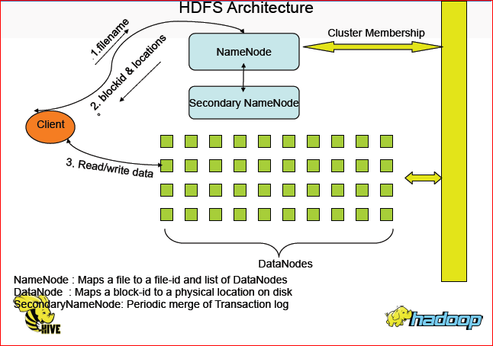
Hadoop Architecture

Slide 13
Hadoop's role in BI
Hadoop can be leveraged as an ETL Tool to process gigabytes of data.
Nightly batch processes can be extracted using Hadoop Map Reduce.
Hadoop can be used for data profiling and loading to a SQL Support columnar database for Data Mining, predictive analysis and BI Reporting.
Hadoop cluster uses off the shelf commodity machines which are very cheap, so data storage is not an issue.
Company’s archival processes can be relaxed, thereby giving avenues to the business to analyze data beyond the current historical boundaries.
Hadoop is a platform for capturing data at a very low cost per byte in raw form, before it is transformed and structured.
Hadoop can be integrated with existing BI Visualization and ETL tools.

Slide 14
Hadoop vs. RDBMS
Data is simply copied to the data store no transformation is required (RDBMS : Schema must be created before data load)
New data start flowing anytime and appear retroactively (RDBMS: New columns must be created before data for such columns can be loaded)
Load is fast (RDBMS : Read is fast)
Flexibility/Agility (RDBMS:Standards/Governance)
Just in Time (RDBMS: Up front Design)
Consolidation Sharing (RDBMS – Silos)
Keep the data Alive (RDBMS - Archive to Tape)

Slide 15
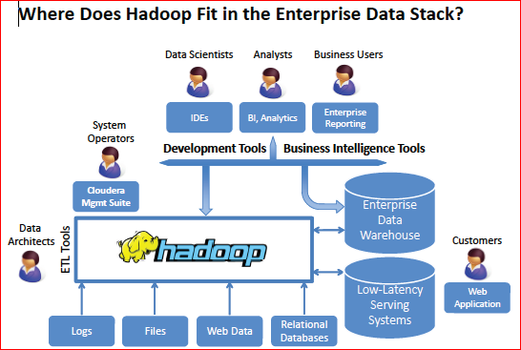

Slide 16
Performance Consideration
Suppose you have some files to process that are 100TB in total. If you had all that on one server that was able to read the files at a rate of 100MB/s, then it would take that server (100 x 10^12) / (100 x 10^6) = 10^6 = 1,000,000 seconds to read the files.
Now suppose you have 100 servers each with a single SATA controller and the files are distributed across all 100 servers so that each server has 1TB to read. At 100MB/s a server will take (1 x 10^12) / (100 x 10^6) = 10,000 seconds to read its data. Since all 100 read the data in parallel, your total read time is 10,000 seconds, i.e. 100 times faster.
Hadoop essentially scales linearly, so if you had 1000 servers in your cluster then you could read all 100TB in just 1,000 seconds, i.e. less than 20 minutes.

Slide 17
Ease of Use
For Analyst type end users, the only skill needed is SQL (using Hive on top of Hadoop) which most of the Analysts are used to due to experience with RDBMS.
For business users, visualization tools (like Karmasphere Analyst or Tableau) can be used with Hadoop
Growing community of open source for developers

Slide 18
Risks of using Hadoop
Relatively new technology. Lower maturity.
HDFS instances communicate with a single named server node, creating a single point of failure if the named server goes offline. When this occurs, the HDFS instance must restart and pick up where it left off, causing significant delays in work processes of the system.
HDFS is not an ACID ??? (atomicity, consistency, isolation, durability) compliant database, and this eliminates HDFS as a primary data source for highly critical enterprise data.
Commercial distributions of Hadoop like Cloudera’s CDH can mitigate some of the risks of open source and ensure a level of support needed by enterprises .
In 2014, SPLICE Machine developed ACID Complaint database for Hadoop.
Scarce resources with Hadoop skills in installation, configuration and development
Initially expert consultants may need to be hired by a company trying to introduce these new technologies.

Slide 19
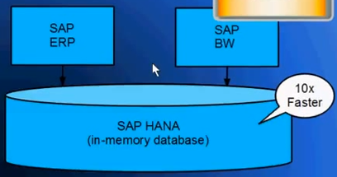
SAP HANA
In memory DB solution.
RAM, solid state drives, multi core processors
SAP HANA serves both OLTP and OLAP.
SAP HANA is ACID compliant and DB transactions are processed reliably.
Automicity (all / nothing), consistency (consistency violation will restore to prev state)
Isolation(multiple trans shouldn’t affect each other), Durability (backups &logs help)

